Slide 1
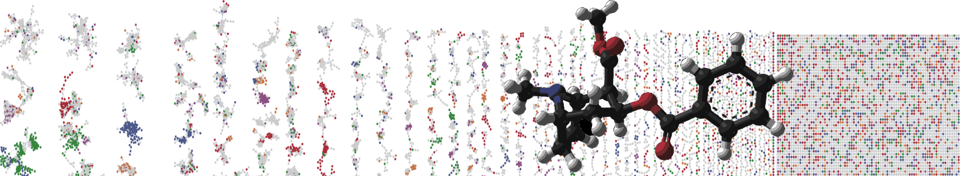


GNPS Molecular Networking Enhancer
Hands On
Allegra Aron
Alan Jarmusch
Mingxun Wang
University of California - San Diego

Slide 2
GNPS Documentation
Classical Molecular Network
https://ccms-ucsd.github.io/GNPSDocumentation/networking/
Feature Based Molecular Networking
https://ccms-ucsd.github.io/GNPSDocumentation/featurebasedmolecularnetworking/
Merge Network Polarity
https://ccms-ucsd.github.io/GNPSDocumentation/mergepolarity/

Slide 3
What do we need?
Positive Molecular Network Job
https://gnps.ucsd.edu/ProteoSAFe/status.jsp?task=0834479d2e2c487994aa6f68253a209d
Negative Molecular Network Job
https://gnps.ucsd.edu/ProteoSAFe/status.jsp?task=a40b5a63ef4d4e16830a7293f5a3181f

Slide 4
Merged Network
https://proteomics2.ucsd.edu/ProteoSAFe/status.jsp?task=34a6a40274c341d0b51fd7d3d974fe2c

Slide 5
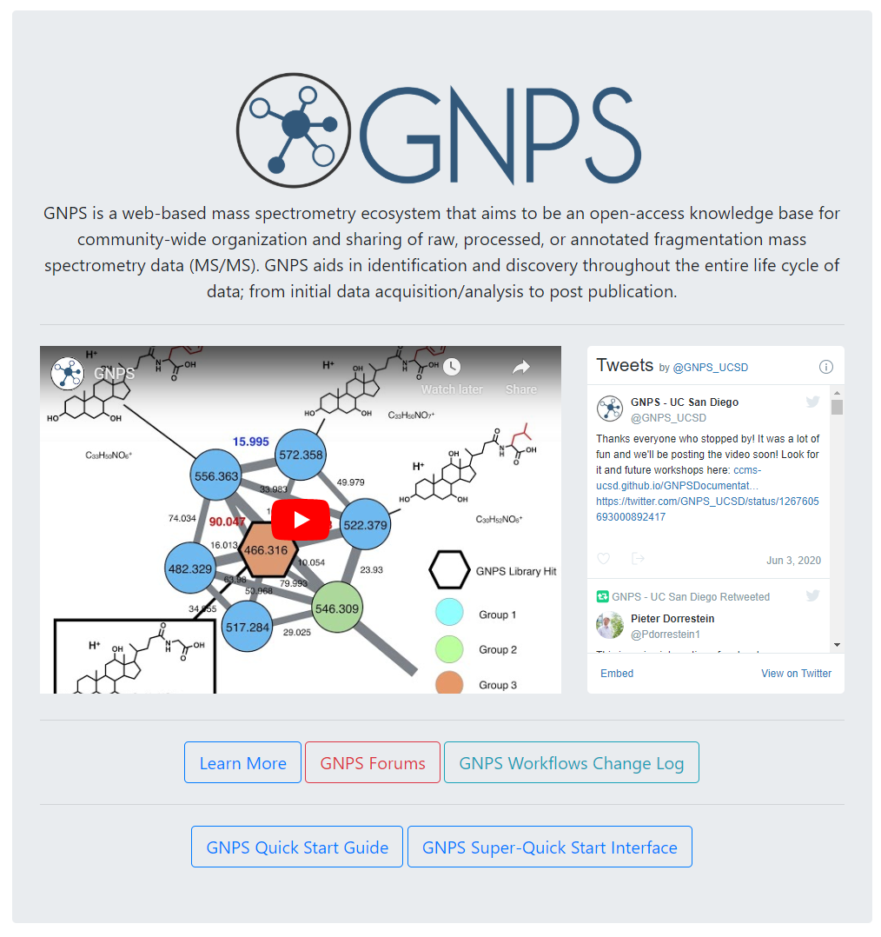
Go to gnps.ucsd.edu
Create GNPS Account
Click on Learn More

Slide 6
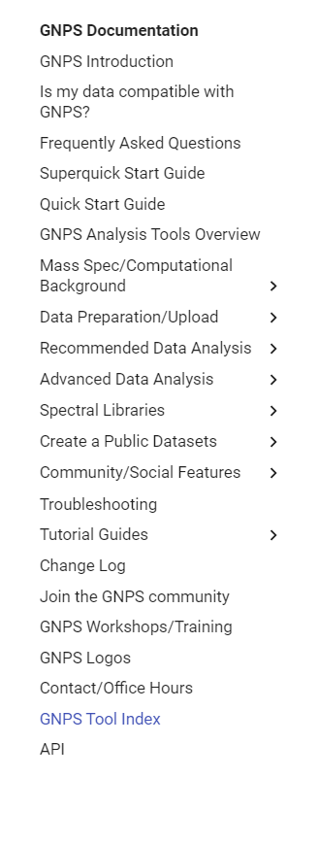
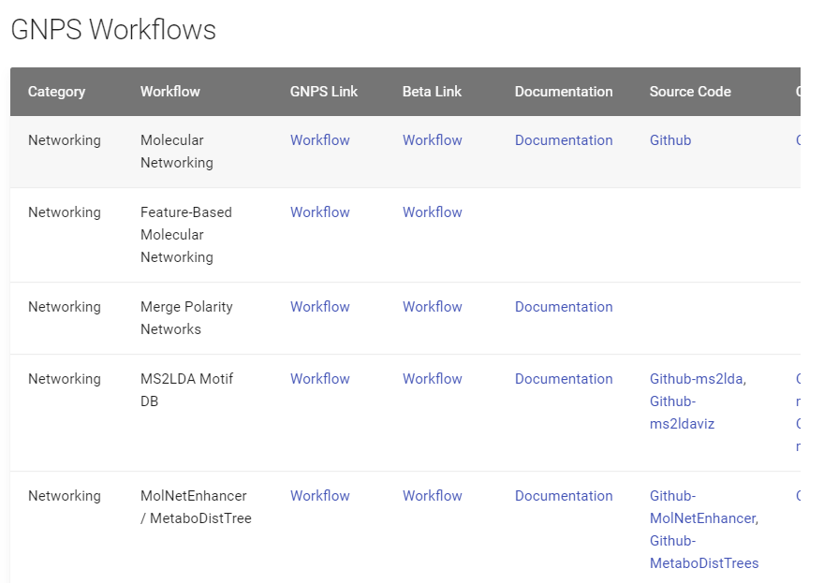
Go to Tool Index
Find Merge Polarity Networks
Link

Slide 7
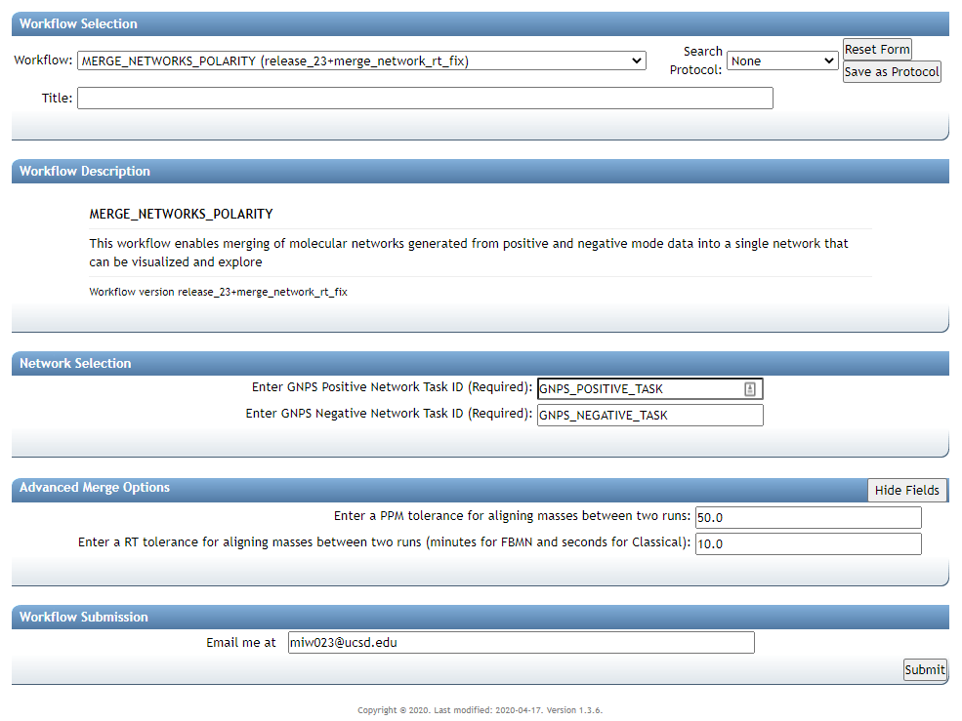

Slide 9
Positive Molecular Network Job
https://gnps.ucsd.edu/ProteoSAFe/status.jsp?task=0834479d2e2c487994aa6f68253a209d
0834479d2e2c487994aa6f68253a209d

Slide 10
Negative Molecular Network Job
https://gnps.ucsd.edu/ProteoSAFe/status.jsp?task=a40b5a63ef4d4e16830a7293f5a3181f
a40b5a63ef4d4e16830a7293f5a3181f

Slide 11
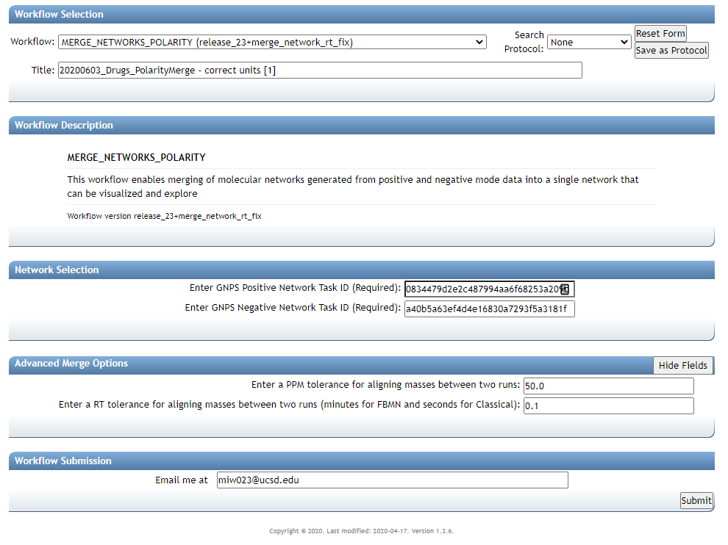
FBMN – in minutes
Classical Network - seconds

Slide 12
Add Email
Submit Network

Slide 13
Merged Network
https://proteomics2.ucsd.edu/ProteoSAFe/status.jsp?task=34a6a40274c341d0b51fd7d3d974fe2c

Slide 14
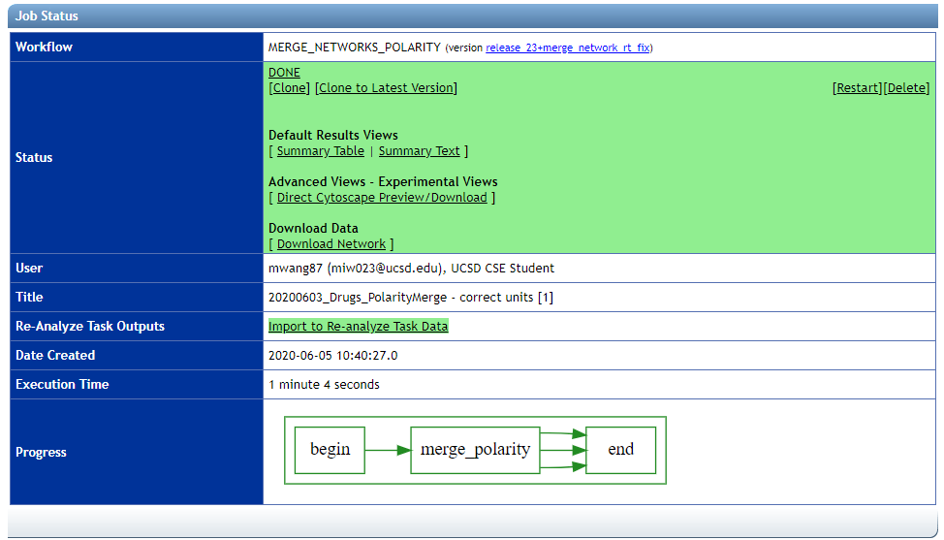

Slide 16
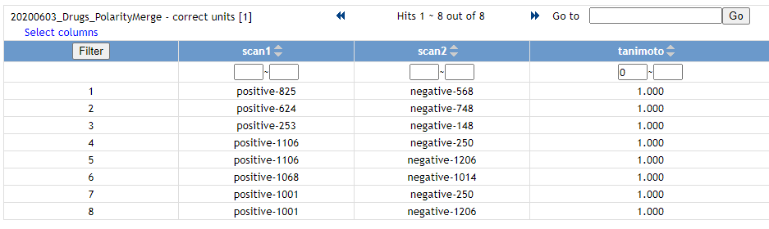
Check Quality of Merging

Slide 18
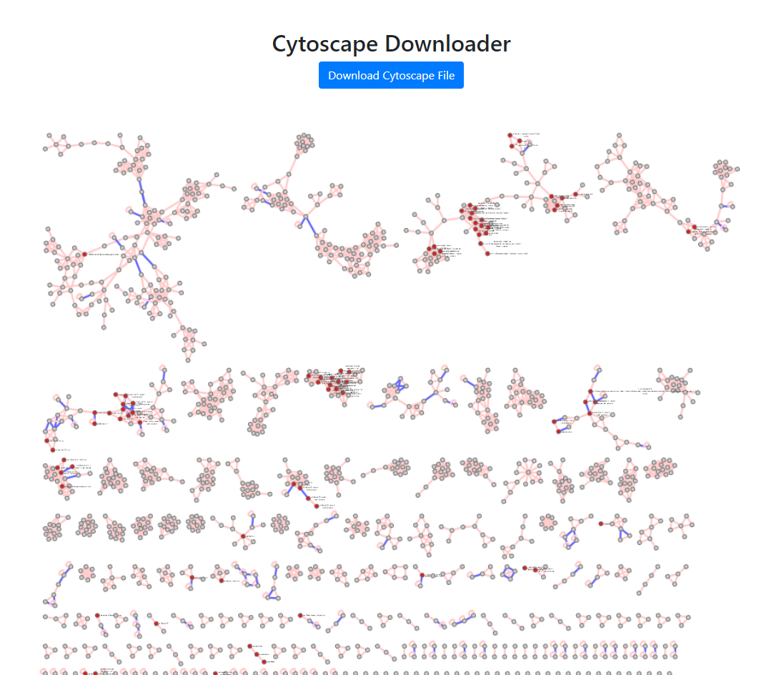
Blue Edge – Polarity Edge
Red Nodes - Identified

Slide 19
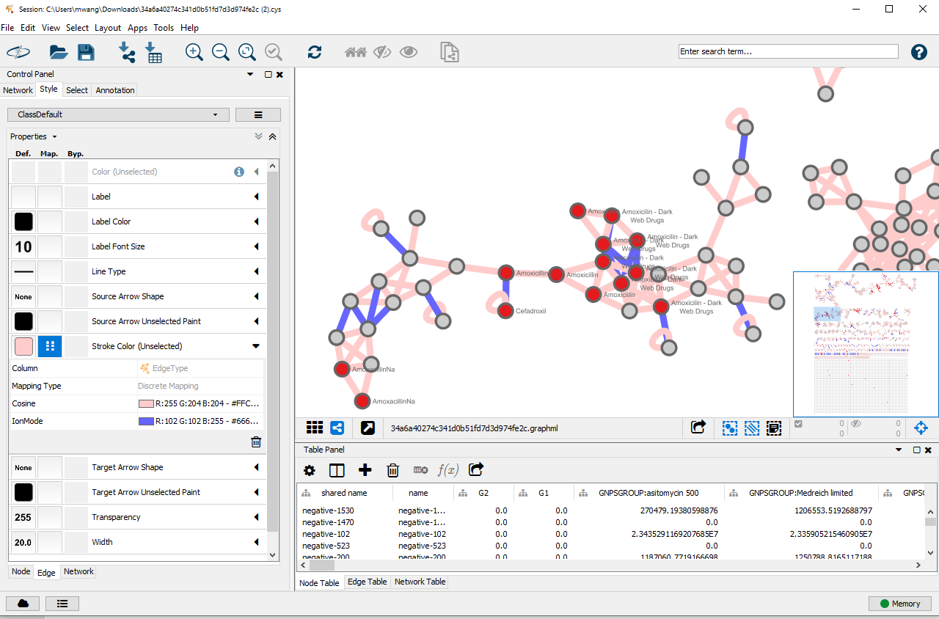
Explore your Molecular Network in Cytoscape

Slide 20
Questions, Problems or Bugs?
Documentation: https://ccms-ucsd.github.io/GNPSDocumentation/
Forum: https://groups.google.com/forum/#!forum/molecular_networking_bug_reports
Allegra Aron
Alan Jarmusch
Mingxun Wang

